Slide 1

DATA STORYTELLING WITH VISUALIZATION
WQD7001

Slide 2
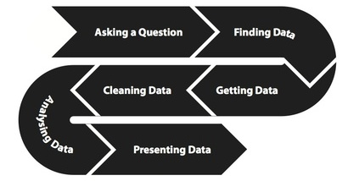
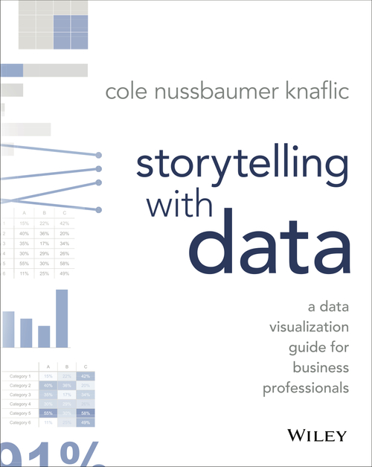
Don't simply show your data—tell a story with it!
Key Skill - the ability to communicate findings clearly and effectively.
“People hear statistics, but they feel stories.” Forbes, March 2016
“Telling a compelling story with your data helps you get your point across effectively.” InformationWeek, May 2016

Slide 3
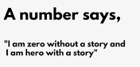
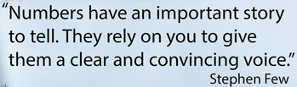

Data without story is of no use.
Stories don’t have graphs.
Real data storytelling is a way to share facts in the form that your listener understands, appreciates and remembers best – the story.
Like any other story, a data story is about a person, a goal, and a challenge. Unlike some other stories, data stories must be true, not just emotionally, but factually.
Data stories have the same elements as ordinary stories, backed up by data.
https://towardsdatascience.com/storytelling-for-data-scientists-317c2723aa31

Slide 4

Stories or Data: Which Makes the Stronger Case?
An experiment “the identifiable victim effect“ carried out by Prof. Deborah Small (Carnegie Mellon University)
Given a sum of money ($5) and asked to donate some amount to TWO conditions:
Data - A statistical condition (statistics on food shortages in Malawi, lack of rain in Zambia, and the dislocation of millions in Angola which effect 3 million children in Africa).
Story - An identifiable condition (“Rokia, a 7-year-old girl from Mali, Africa, is desperately poor and faces a threat of severe hunger or even starvation. Her life will be changed for the better as a result of your financial gift. With your support, and the support of other caring sponsors, Save the Children will work with Rokia's family and other members of the community to help feed her, provide her with education, as well as basic medical care and hygiene education.").
https://www.thegoodmancenter.com/wp-content/uploads/2013/07/free_range_2009_12.pdf

Slide 5
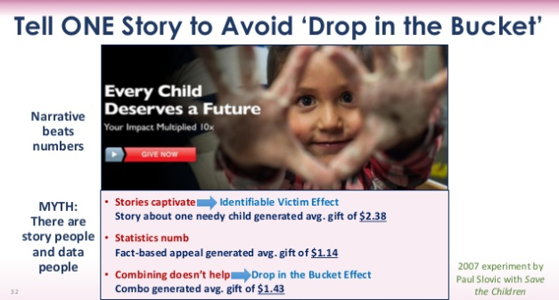
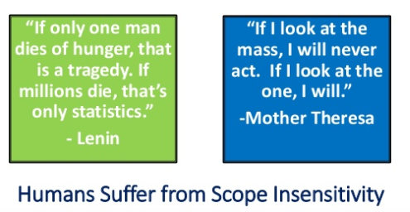
Lesson One: A Story Beats Data
On average, students who received the fact-based appeal from Save the Children donated $1.14. Students who read the story about Rokia donated an average of $2.38, more than twice as much.
Lesson Two: A Story Beats a Story Plus Data
This letter told Rokia's story but also included statistics about persistent drought, shortfalls in crop production, and millions of Africans who were going hungry. Those who read the story plus the data donated an average of $1.43.
“Drop-in-the-bucket” effect
If we feel overwhelmed by the scale of the problem, we often do little about it. Researchers theorized that focusing on statistics short-circuits a compassionate response by shifting people into an analytical frame of mind. And when people think analytically, it can hinder their ability to act compassionately.

Slide 6


Humanitarian Appeal for Donation
This man who is crying is a doctor. While he was distributing bread to the war struck children in Syria the child told him; “Could you give me a medicine so that I won't feel hungry again?”
Please help protect children in Syria today
Together we could do something good
http://www.syriacare.org.my/donate/

Slide 7
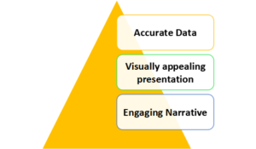
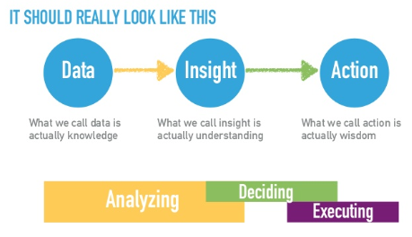
Stories provoke thought and bring out insights that could not have been understood or explained before.
Story is data-driven.
Data storytelling weaves data and visualization into a narrative tailored to a specific audience in order to convey credibility in the analytical approach, confidence in the results and a compelling set of insights that is actionable to the audience.
Data visualization as story telling is only half of the story.

Slide 8
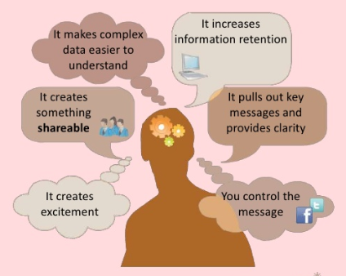
Why Present Data Visually?

Slide 9
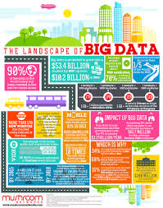
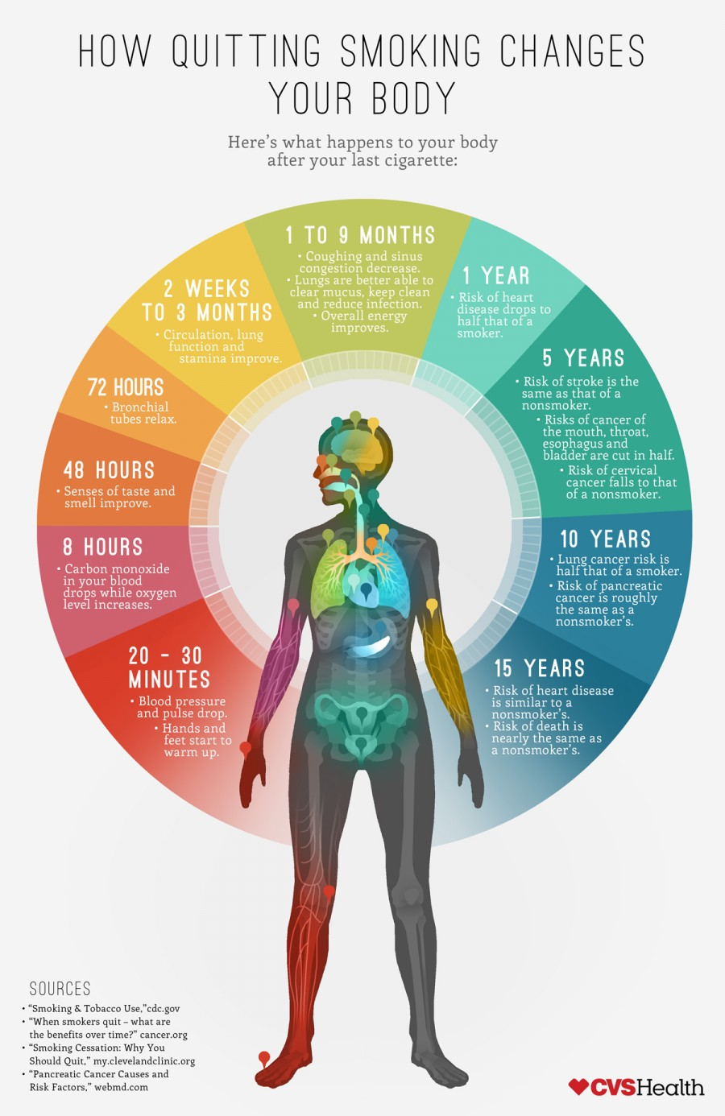
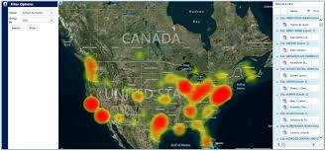
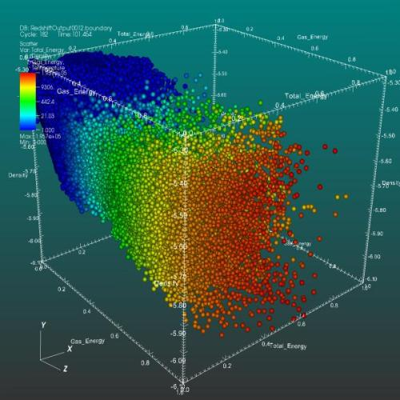
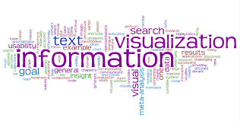
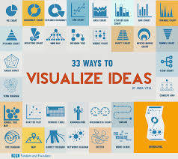
The Importance of Visualization
Infographics - a great way to convey information about data.

Slide 10
Data Visualization
Data visualization (simple or complex) helps us make sense of data, but rarely generates insights that stimulate action.
All business narratives are designed to help people to take action.
Stories are always about experiences people have, help listeners make an experience that's being shared personally meaningful. If designed in a certain way, those stories can inspire listeners to take action.
So data visualizations are terrific tools to use when telling the data story because they provide credibility and give weight to points being made in the story.
It involves communicating findings and insights effectively through graphical means (graphs, charts, mind maps, infographics, and other visuals).

Slide 11
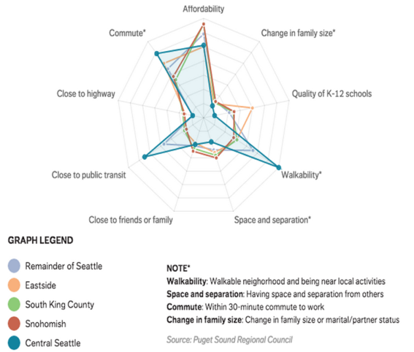
How Seattle Residents Determine Housing
Radar Chart

Slide 12
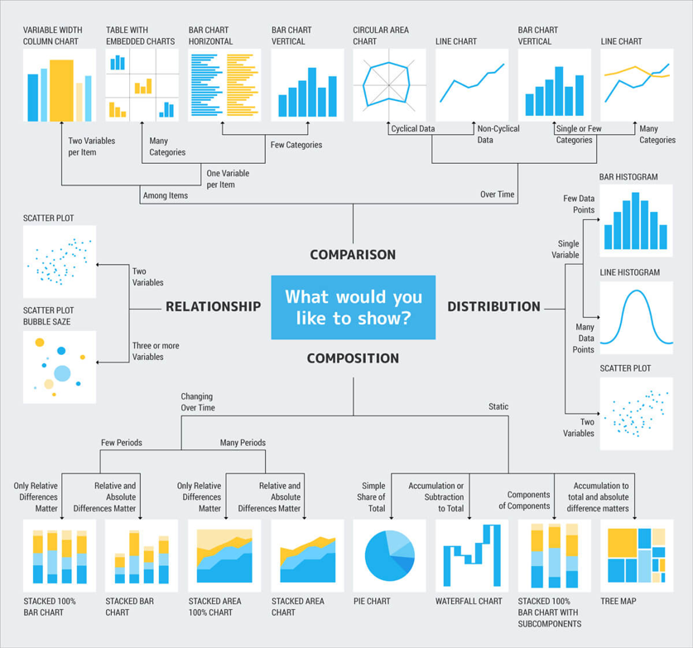
Crazy Egg does a great job of summarizing potential data storytelling visuals (how meta!) by grouping them by relationship, comparison, distribution, or composition.

Slide 13
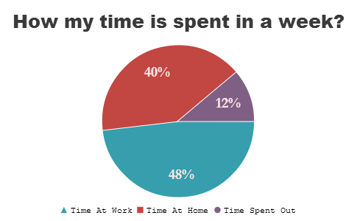
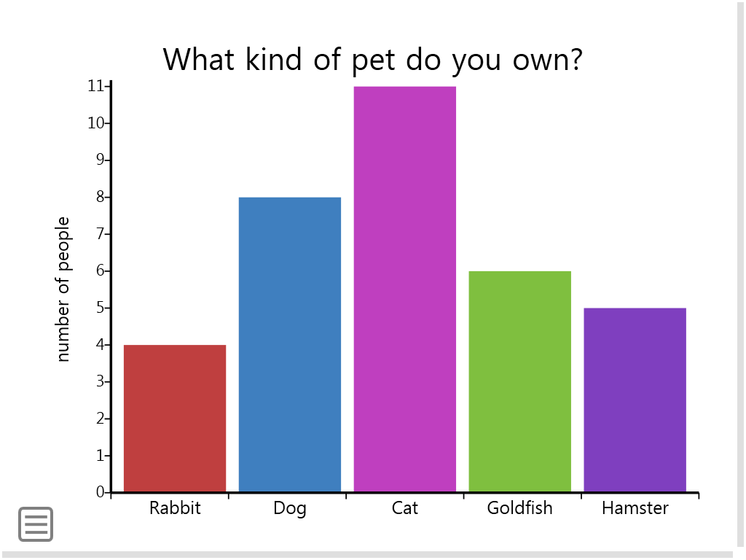
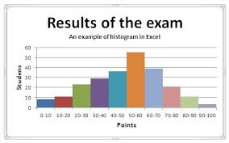
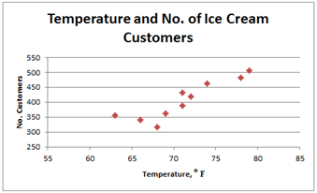
Quantitative Data
Quantitative data is information about quantities; that is, information that can be measured and written down with numbers.
Some other aspects to consider about quantitative data:
Focuses on numbers
Can be displayed through graphs, charts, tables, and maps
Data can be displayed over time (such as a line chart)
See https://datavizcatalogue.com/

Slide 14
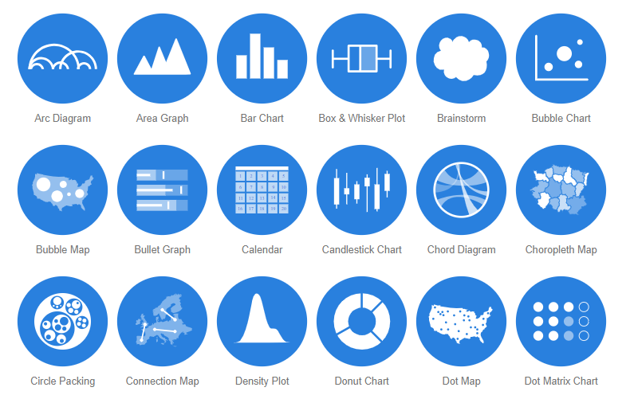
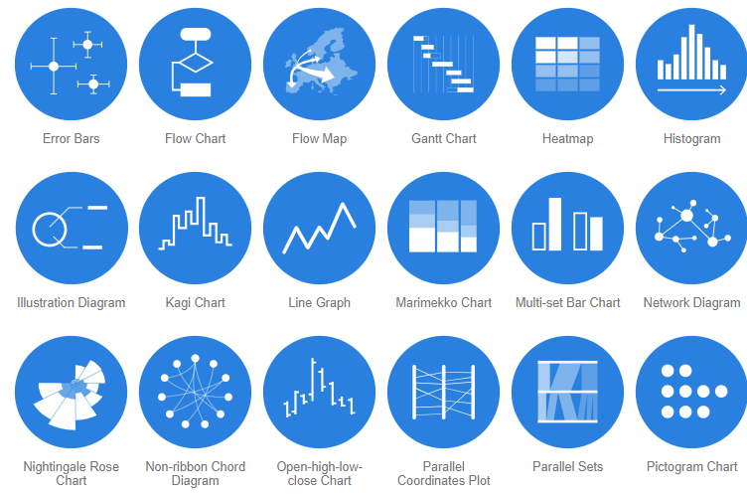
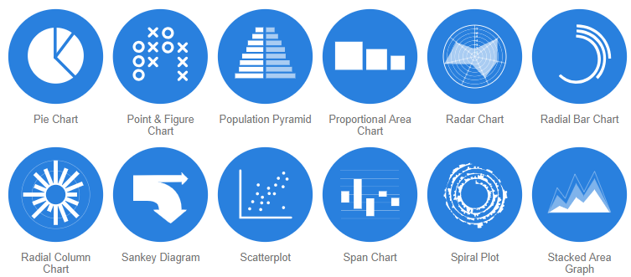
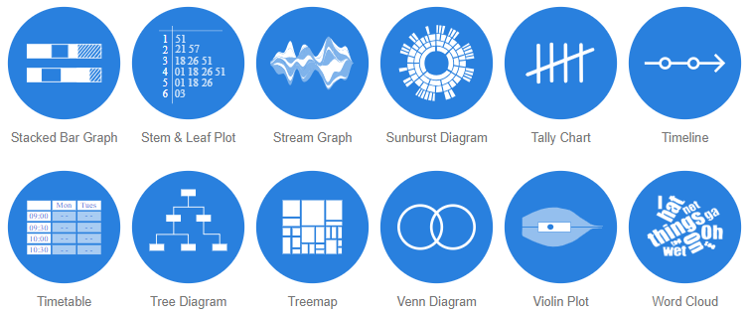

Slide 15
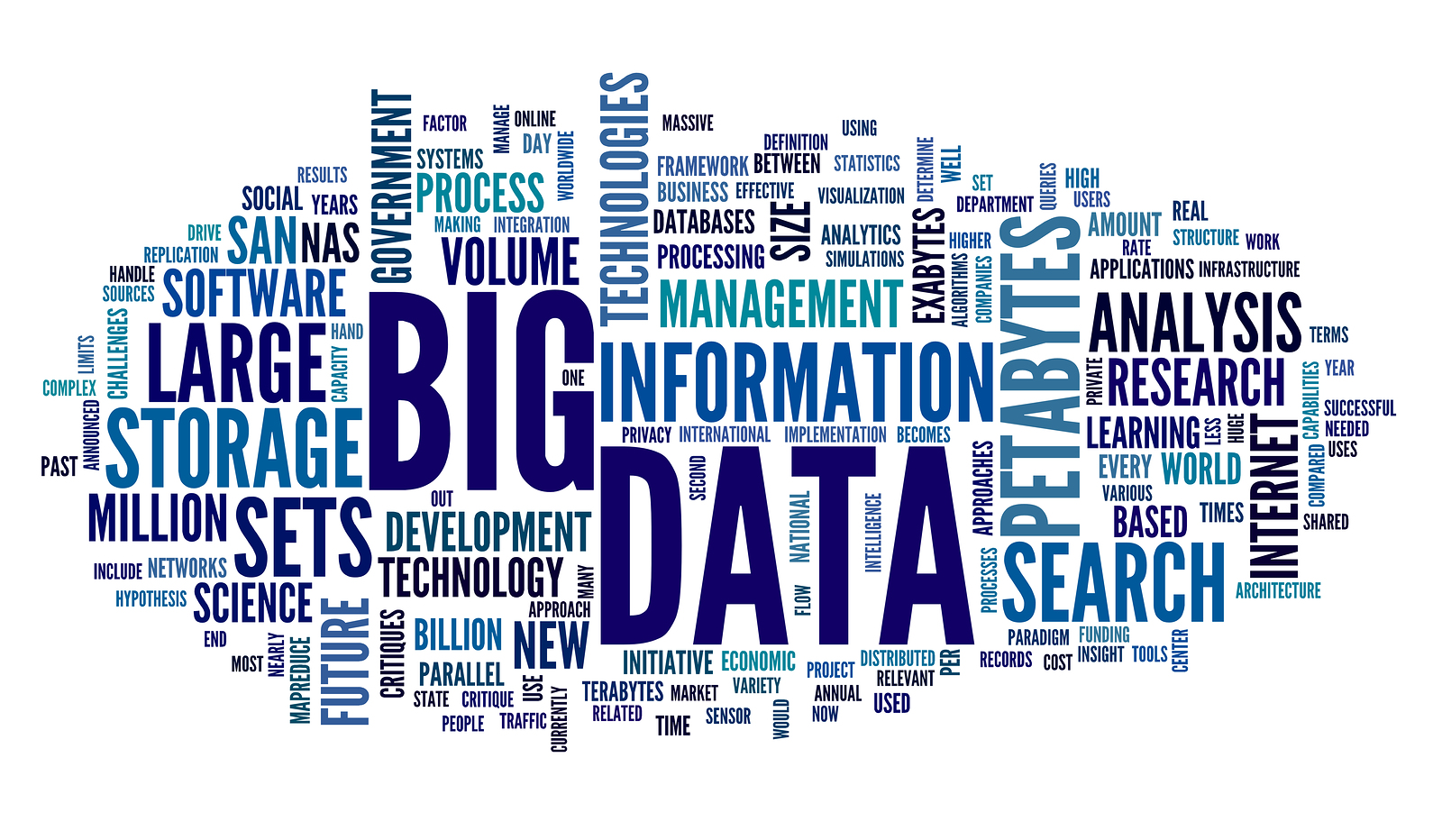
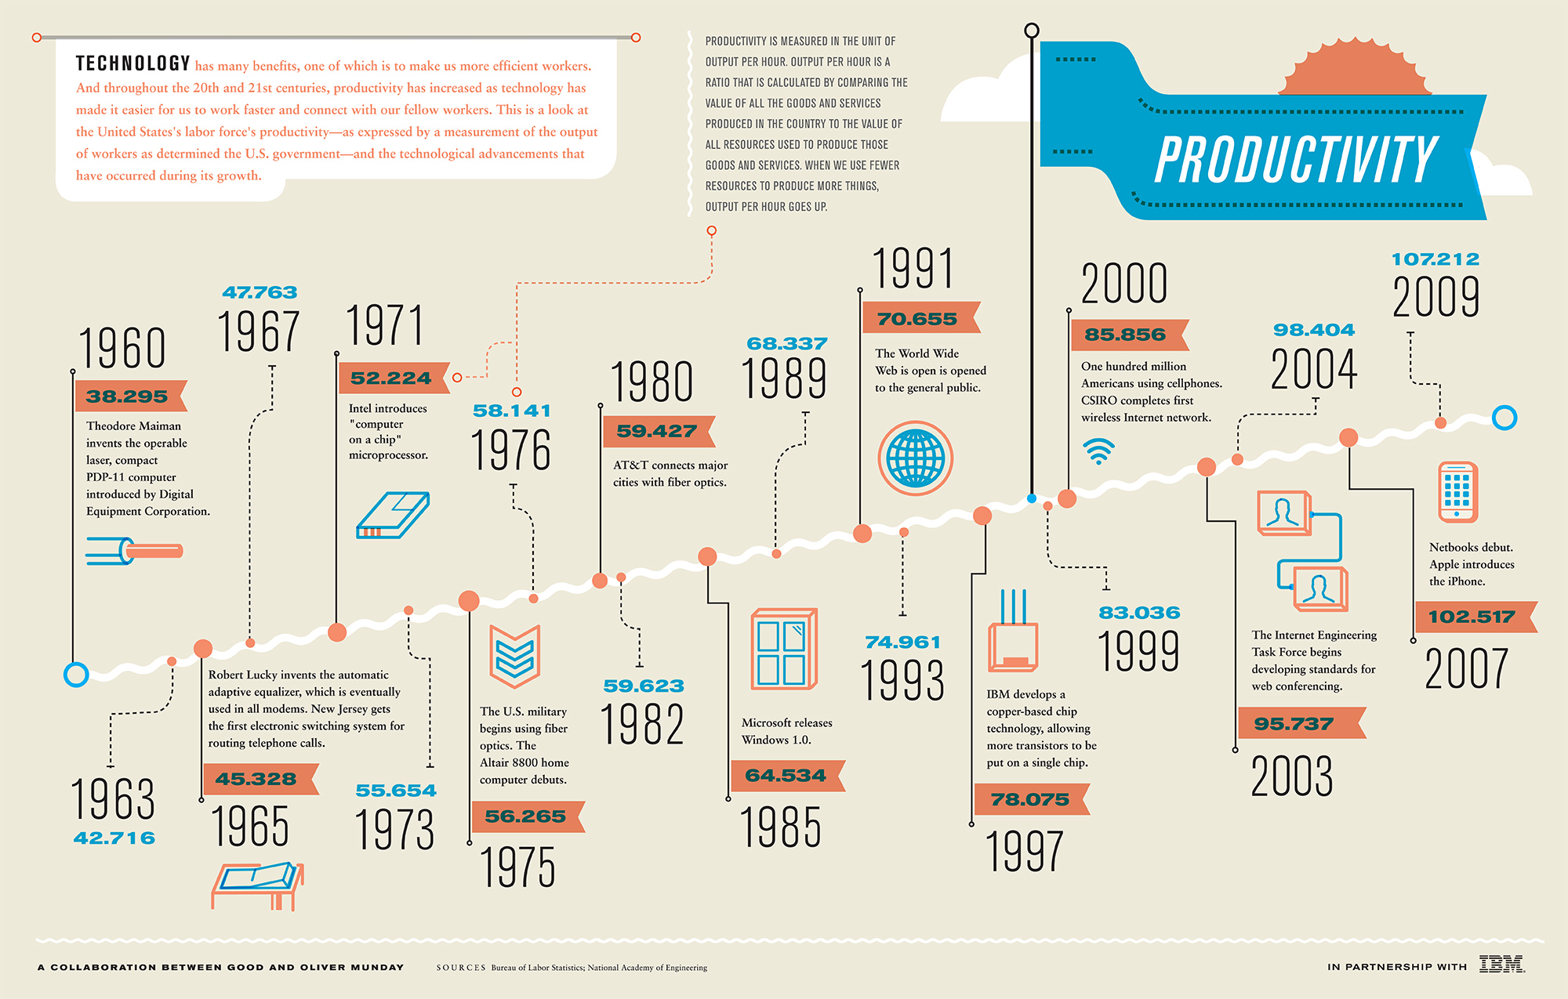
Qualitative Data
Qualitative data is information about qualities; information that can't actually be measured.
Some other aspects to consider about qualitative data:
Represented through pictures that explore the data in a visual way
Visual representations focus on the themes found in the data
Can tell a story
Can also be displayed graphically as a pie chart or bar graph, the same as quantitative data, however, this can be tricky and can be done incorrectly easily.
See http://stephanieevergreen.com/qualitative-chart-chooser/
Reference:
https://guides.auraria.edu/c.php?g=528873&p=3964258

Slide 16
Exploratory analysis is what you do to get familiar with the data. You may start out with a hypothesis or question, or you may just really be delving into the data to determine what might be interesting about it.
Explanatory analysis is what happens when you have something specific you want to show an audience .
Here are three ways we can move beyond simply showing qualitative data:
Use color to draw the audience’s attention to the most important aspects.
Reduce the amount of text: pithier, more concise wording will help the audience process the information more efficiently.
Evaluate the audience’s needs: consider quantifying the data if doing so provides important context.

Slide 17
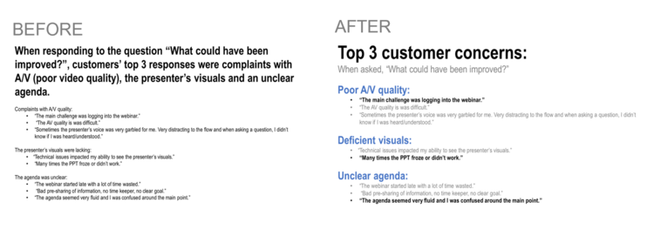
The power of color:
To illustrate, check out the difference between how you process these two blocks of text:
http://www.storytellingwithdata.com/blog/2018/10/10/three-tips-for-storytelling-with-qualitative-data

Slide 18
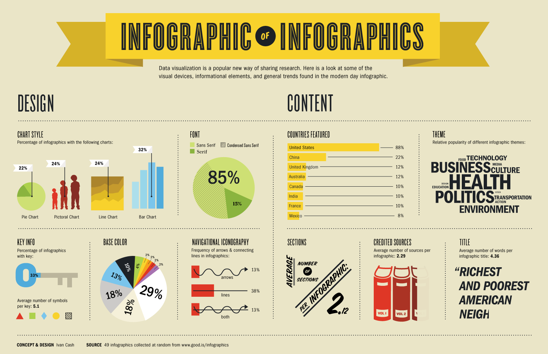
Ideas for Displaying Qualitative Data
https://blog.visme.co/solutions-to-creating-infographics-part-2-rules-in-designing-your-infographic-layout/

Slide 19

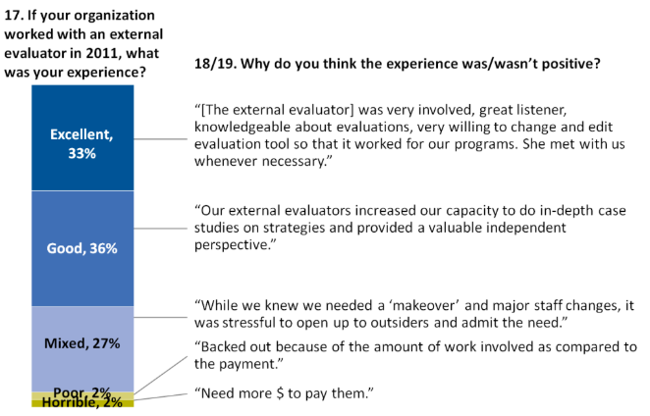
Ideas for Displaying Qualitative Data
Showcasing Open-Ended Survey Data Beside Closed-Ended Data
Photos Beside Participants’ Responses

Slide 20
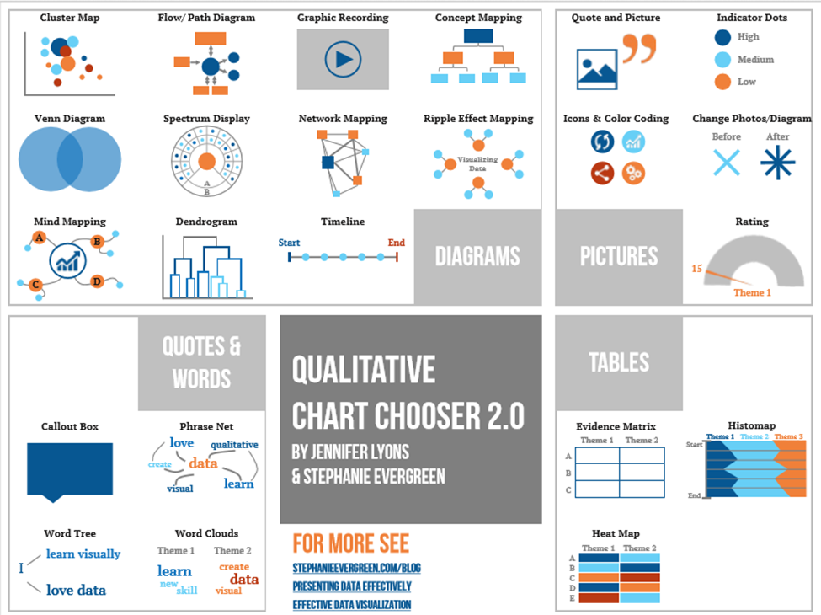

Slide 21
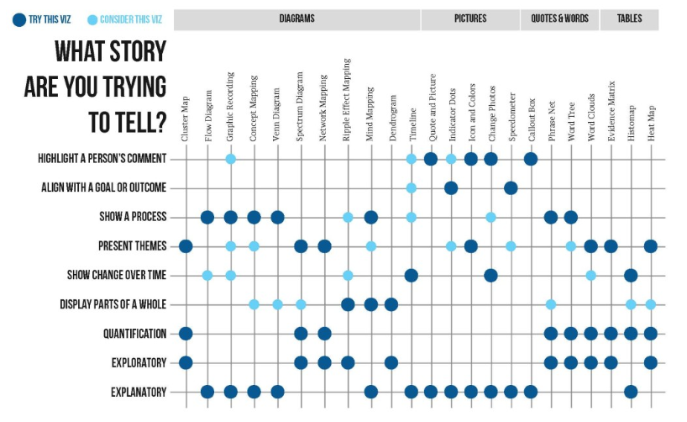
http://stephanieevergreen.com/qualitative-chart-chooser/

Slide 22
Data Storytelling
The phrase - associated with data visualizations, infographics, dashboards, word clouds and so on.
Data storytelling - interpreted as just visualizing data effectively!
Much more than just creating visually-appealing data charts.
Data storytelling is a structured approach for communicating data insights, and it involves a combination of three key elements: data, visuals, and narrative.

Slide 23
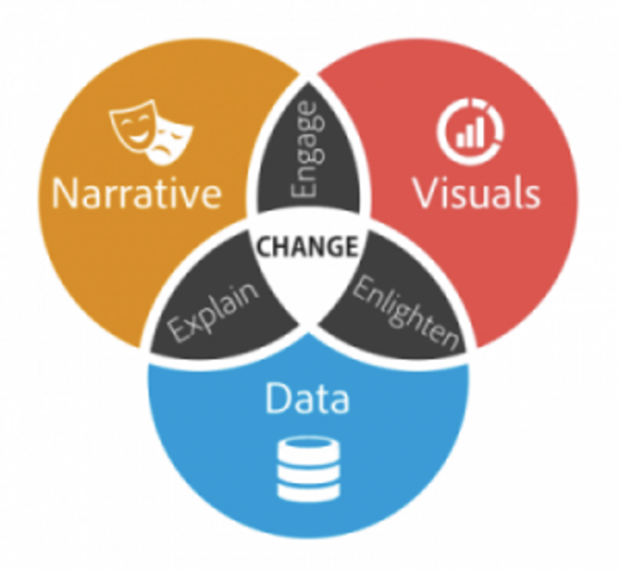

Key Elements Structured Approach of Data Storytelling for Communicating Data Insights
According to LeAnna Kent, the data scientist at Elder Research, “Data story telling marries data visualization with a guided narrative.
It pairs data and the graph with words. It is not only describing what can be seen in the graph, but also telling a story to lead the audience through the analysis process.”

Slide 24
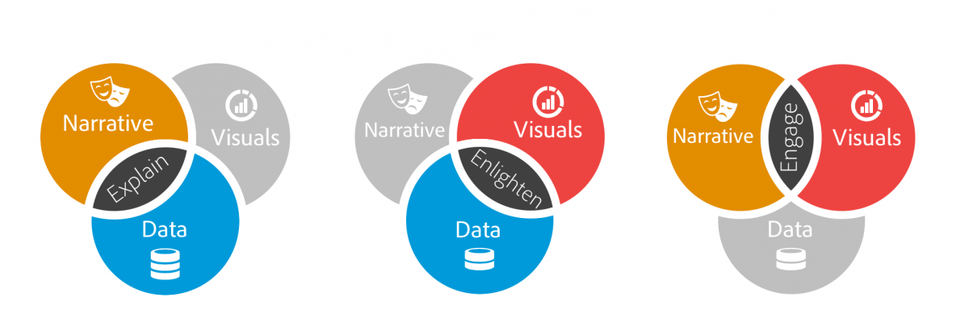
Narrative + Data
When narrative is coupled with data
It helps to explain to your audience what’s happening in the data and why a particular insight is important.
Ample context and commentary is often needed to fully appreciate an insight.

Slide 25
Visuals + Data
When visuals are applied to data
They can enlighten the audience to insights that they wouldn’t see without charts or graphs.
Many interesting patterns and outliers in the data would remain hidden in the rows and columns of data tables without the help of data visualizations.

Slide 26
Narrative + Visual
When narrative and visuals are merged together
They can engage or even entertain an audience.
It’s no surprise we collectively spend billions of dollars each year at the movies to immerse ourselves in different lives, worlds, and adventures.
When you combine the right visuals and narrative with the right data, you have a data story that can influence and drive change.

Slide 27
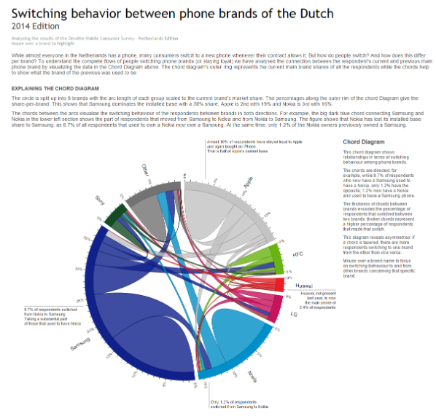
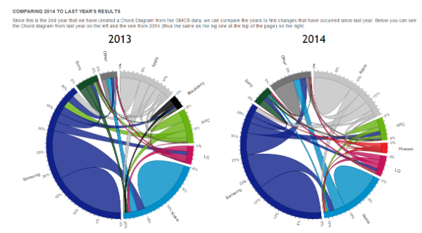
Using “Data Storytelling” with a Chord Diagram
https://www.visualcinnamon.com/blog/
https://www.visualcinnamon.com/2014/12/using-data-storytelling-with-chord

Slide 28
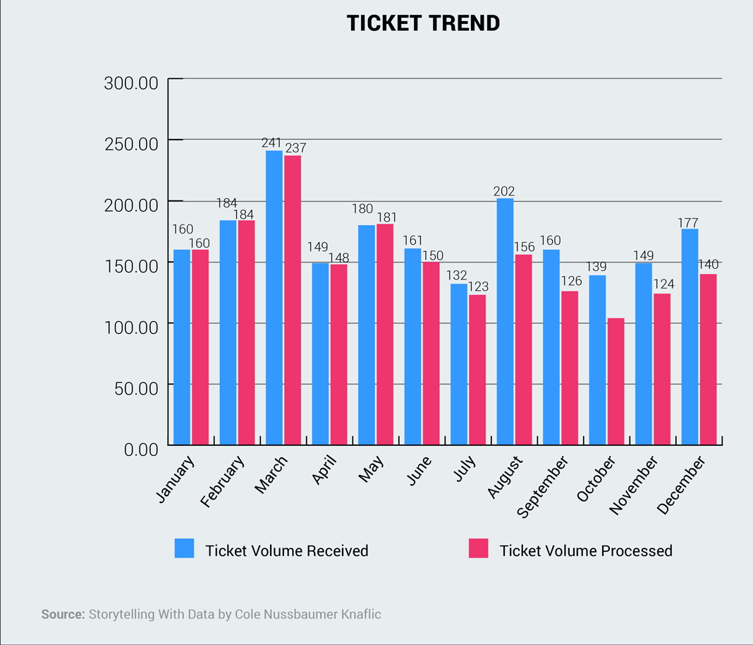
Examples of How to Improve Data Storytelling
Before
This bar chart displays the number of tickets received and processed in a year.

Slide 29
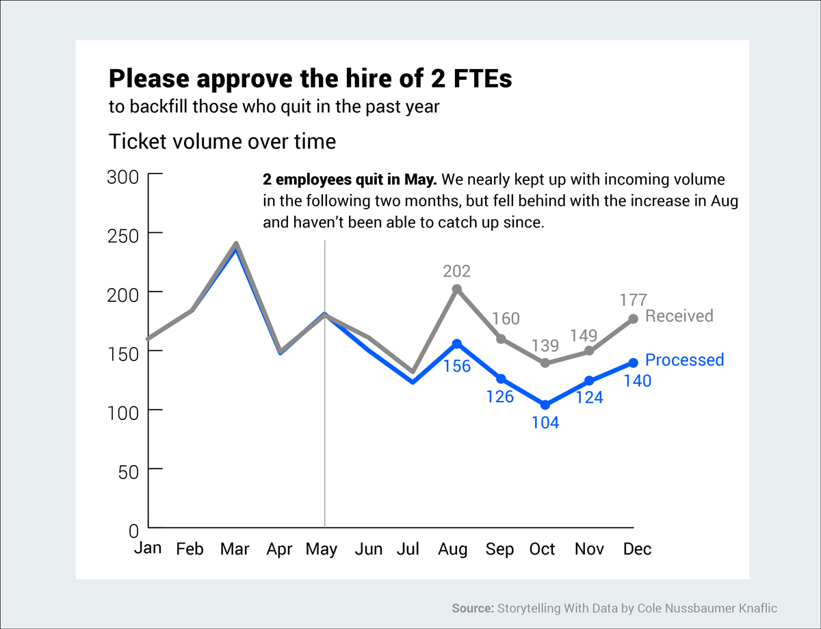
After
If your purpose is to convey a message and move someone to a specific action (in this case, the hire of two new employees), then this is much better.

Slide 30
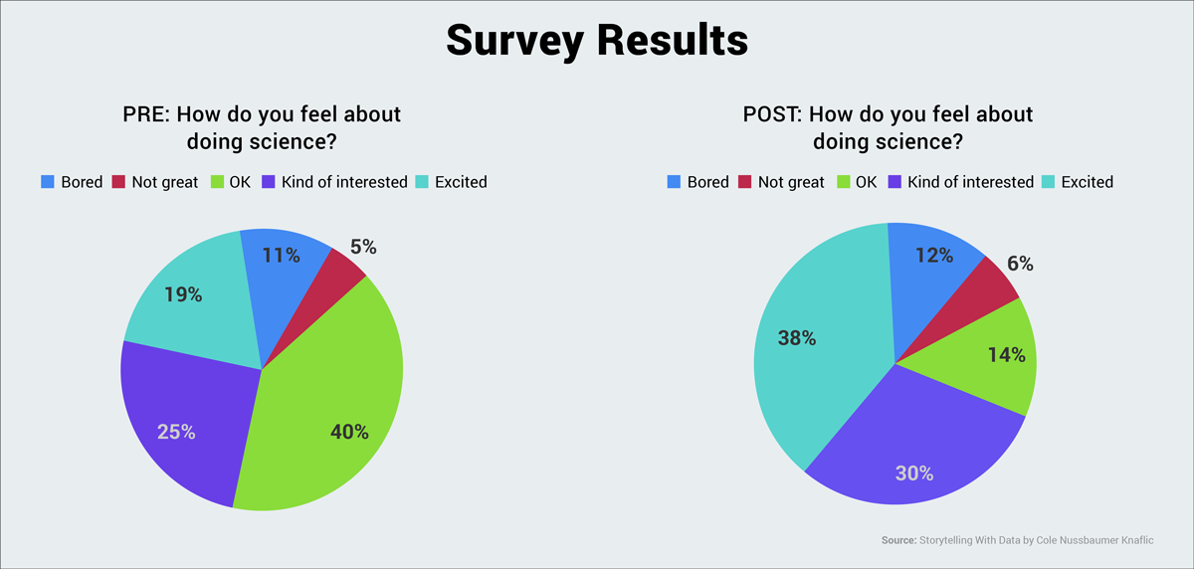
Before
This is another example of data displayed without a narrative or clear message.

Slide 31
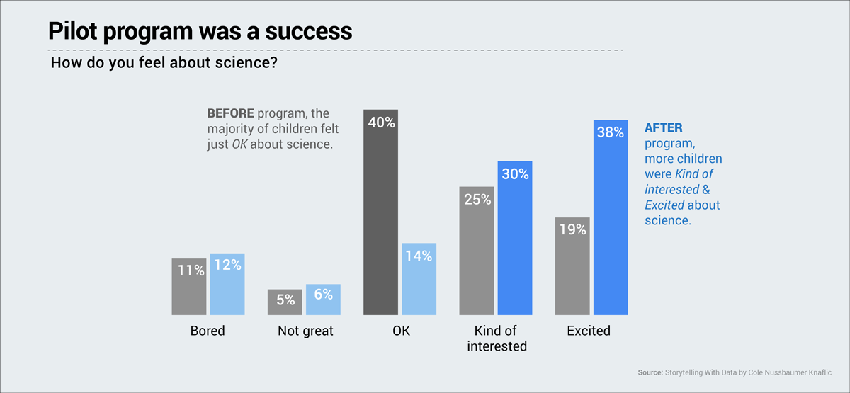
After
Now look at this same data set presented in a completely different manner. Big difference, right? The central message is immediately clear: More children were excited about science after the program.

Slide 32
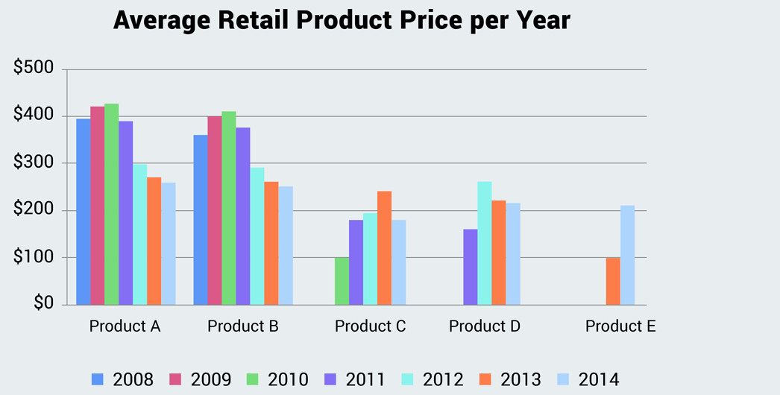
Before
Another example of an ineffective chart that is accurate but does not communicate or persuade an audience to take a specific action.

Slide 33
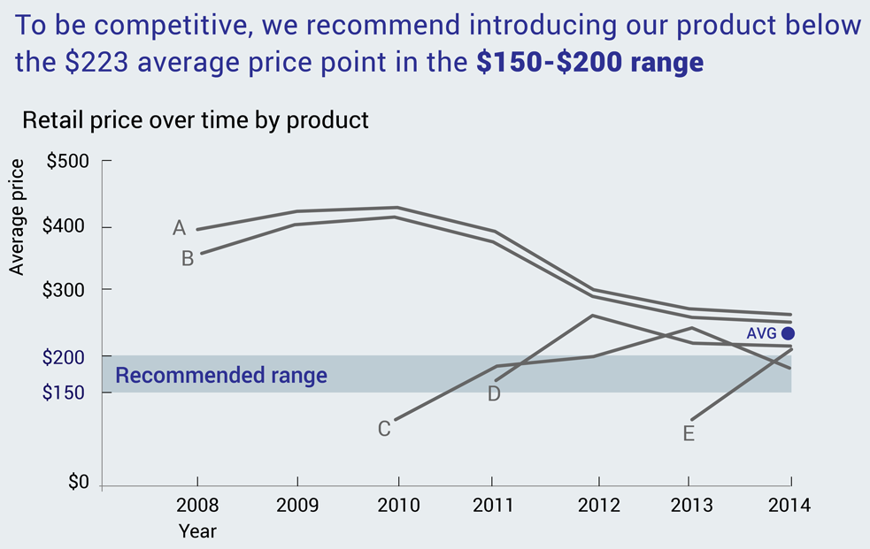
After
In this chart, our eyes are immediately drawn to the blue strip, the gray lines and the blue dot representing the average price point.

Slide 34
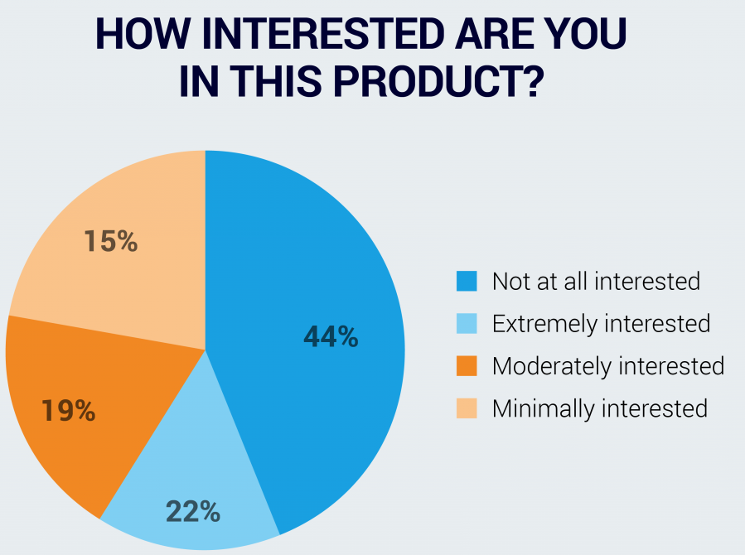
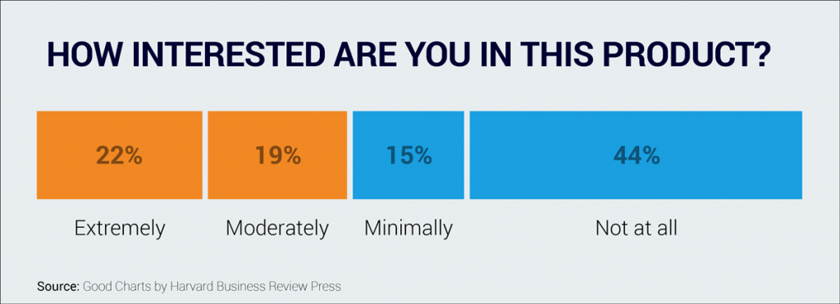
Before
At first glance, this pie chart seems clear enough, but upon deeper analysis, you’ll find that it doesn’t abide by several conventions that allow viewers to quickly grasp the information.
After
This is much easier to decipher at first glance. Arranged according to the values on a scale, we quickly understand that a majority of people are not interested in this particular product.

Slide 35
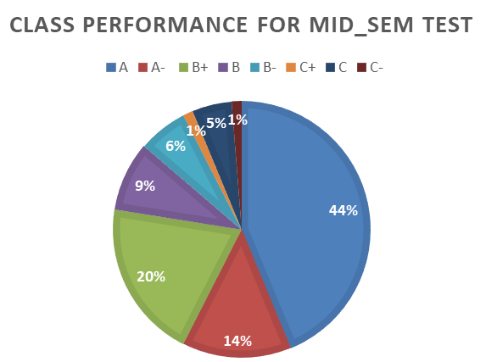
WQD7001 Sem 1, 2018/2019
CLASS PERFORMANCE FOR MID_SEM TEST
44%
14%
20%
9%
6%
1%
5%
1%
A
A-
B+
B
B-
C+
C
C-

Slide 36
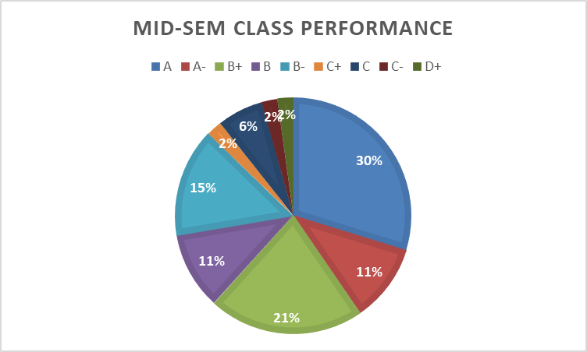
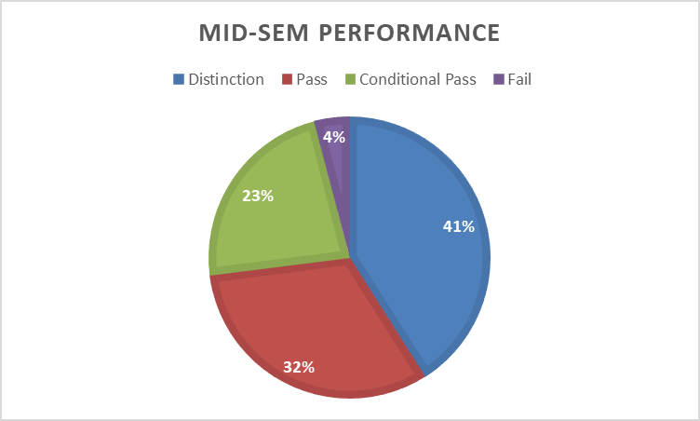
WQD7001 Sem 2, 2018/2019

Slide 37









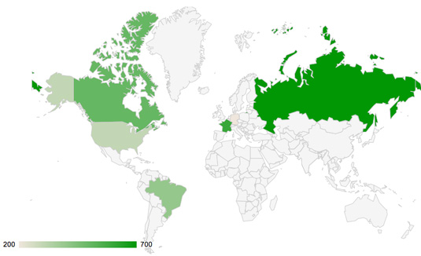


Tools for Data Visualization
https://www.creativebloq.com/design-tools/data-visualization-712402

Slide 38
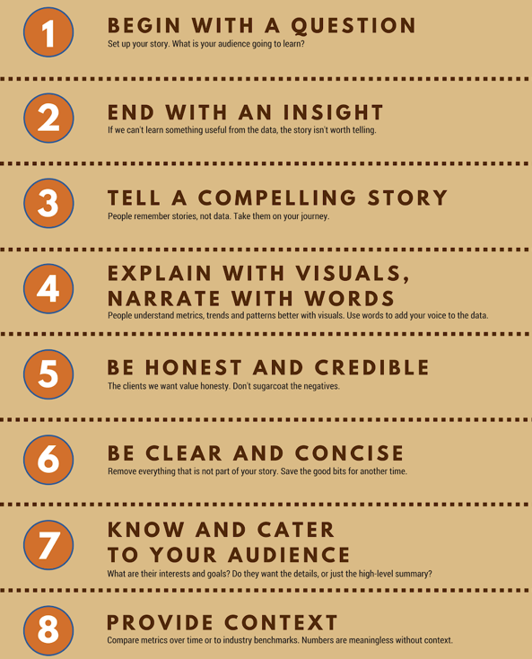


Slide 39
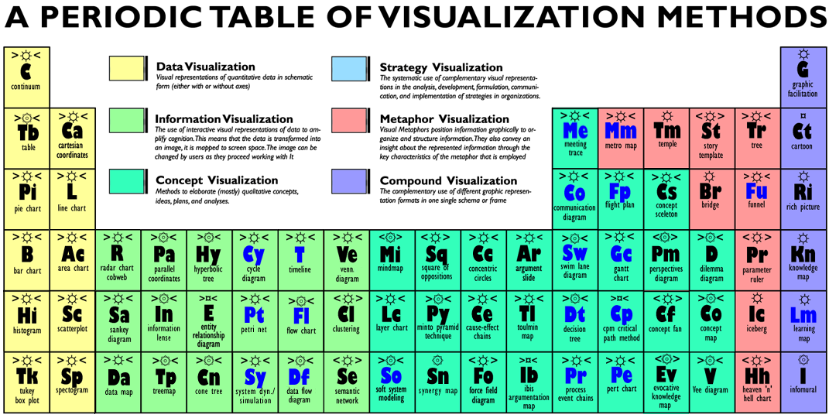
http://www.visual-literacy.org/periodic_table/periodic_table.html#

Slide 40
Credit & References
Data Storytelling: The Essential Data Science Skill Everyone Needs - Brent Dykes
https://www.forbes.com/sites/brentdykes/2016/03/31/data-storytelling-the-essential-data-science-skill-everyone-needs/#7d3ad21e52ad
http://www.visual-literacy.org/periodic_table/periodic_table.html
https://www.juiceanalytics.com/writing/data-storytelling-the-ultimate-collection-of-resources-ii
https://www.import.io/post/8-fantastic-examples-of-data-storytelling/
https://hbr.org/2014/05/10-kinds-of-stories-to-tell-with-data

